Slide 1
UI Patterns

Slide 2
UI Patterns defined so far...
Dashboard container
Dashboard widgets
Datatable
Picklist
Picklist 2
Reveal right

Slide 3
UI Pattern Definitions
A majority of the UI patterns (widgets) we have in our existing application are not provided by Twitter Bootstrap for a variety of reasons.
Made up of UI components that exist in JQuery
UI component standalone exists in JQuery
In many cases styles for a given component exist in TBS because it applies to standard html widgets. (table striping etc.)., but the generation for that object is left open ended to provide more options in interaction or customization.

Slide 4
1. Dashboard (container)
Purpose: display manage and contain “dashboard widgets”

Slide 5
Dashboard Container Requirements
Layout that accommodates drag/drop placement of widgets
1/3-2/3 (or 1/4-3/4) page split
Drop areas that allow resizing of widgets
Ability to turn widgets on/off
Ability to make widget display full-screen
Style Guide Compliance
Font – color, size, type
Colors – background, foreground, text, buttons
Buttons – color, size, type, behavior
Icons
Responsive design to accommodate at least desktop and tablet sizes

Slide 6
Dashboard Requirements
Drag/drop functionality
Responsive design
Ability to collapse widget to title bar
Ability to add menu items (such as cog for Edit Settings and X to close) to title bar
Resizing based on height of contents; location ( 1/3-2/3 or 1/4-3/4 page split)
Resizable within space (drag lower right corner to expand vertically)
Widgets will need to accommodate things like dynamic tables, calendars, etc.
Style Guide Compliance
Font – color, size, type
Colors – background, foreground, text, buttons
Buttons – color, size, type, behavior
Icons

Slide 7
Dashboard - Suggested Solution
Begin by building the dash (It is not a hard thing to build). Use jquery UI for drag and drop and grid resizing.
Containers (portlets) conform to grid widths
Build portlets to specs using tutorial[s] listed for minimize, maximize etc.
Define Visual Displays for standard data
Add the look and feel of a Twitter template, provided it works with the style guide.

Slide 8
Dashboard Container Options
 | Civic Actions tutorial | Steve Pallen Tutorail | Perfectum Skin/Dash | Caldara – UIExample
Page split | x | x | x | x
Resize Widgets | x | x |  | x
Manage Widgets | x | x | x | x
Style Guide | x
Responsive Design | x |  | x | x
Free |  | x |  | x
Description | Tutorial | Tutorial | Plugin? | Theme
Off the market and branded into another product

Slide 9
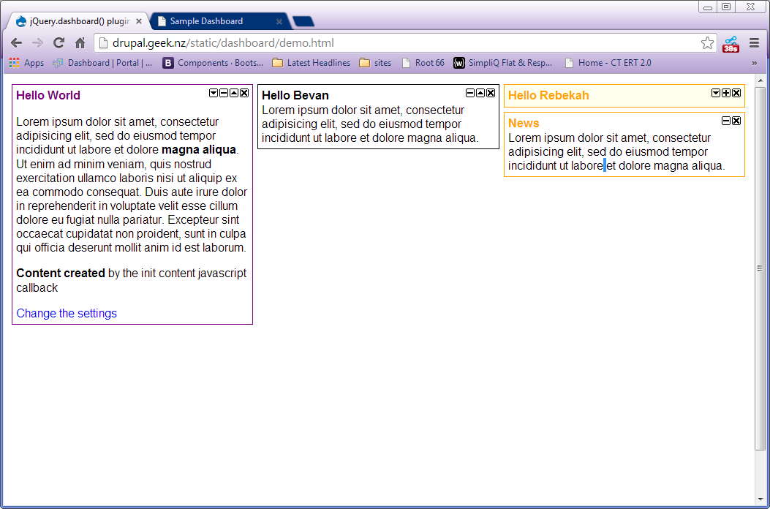
Civic Actions Tutorial (Starting point for in house app)

Slide 10
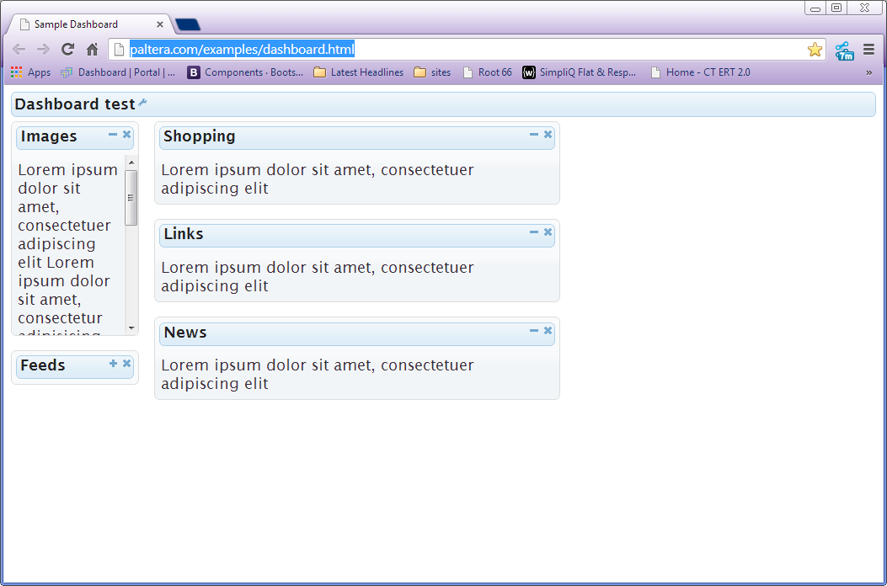
Steve Pallen (Paltera tutorial)

Slide 11
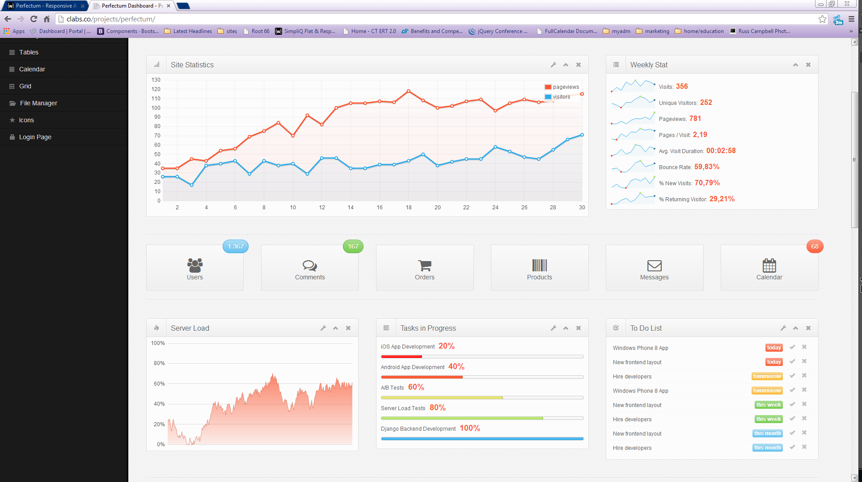
Perfectum Dashboard – $$ (Twitter Bootstrap Theme)

Slide 12
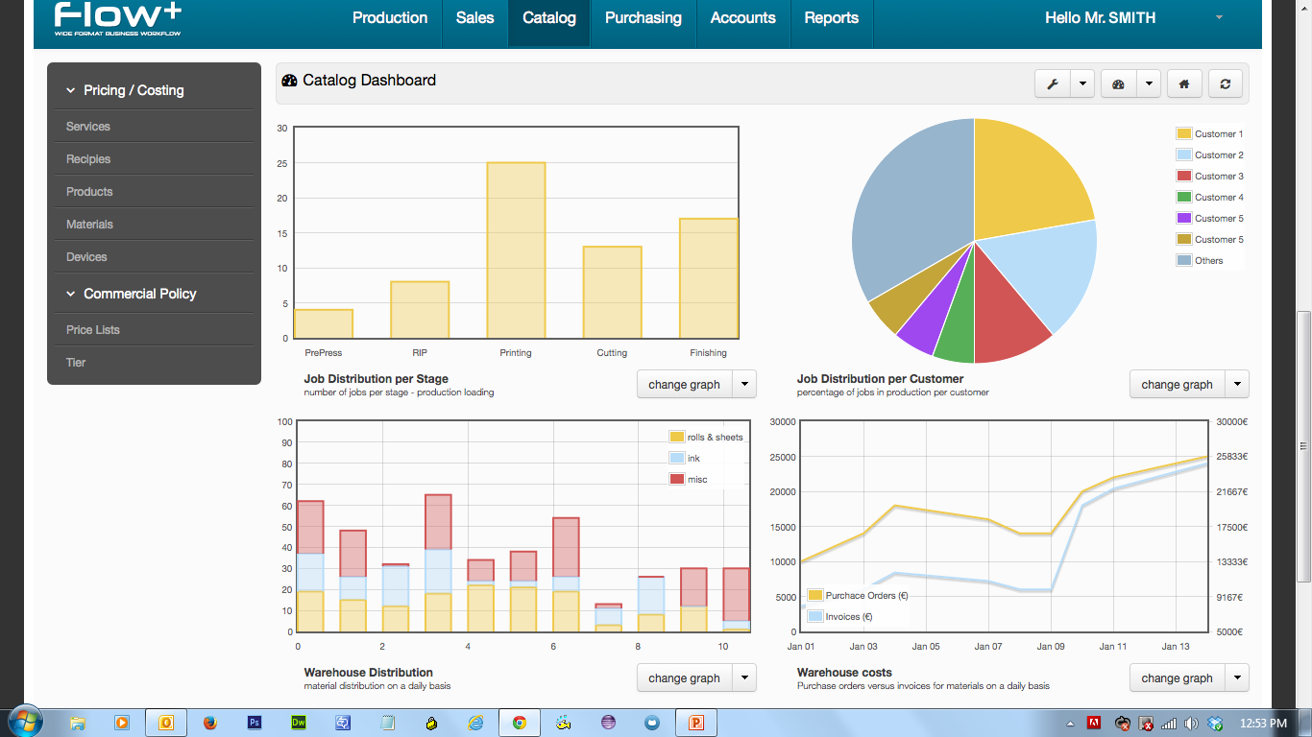
Caldera/Flow Dashboard – UI Example

Slide 13
2. Dashboard Widgets (individual widgets)
Purpose: “House” the individual widgets (these are the containers that we populate with things like the alerts).

Slide 14
Dashboard Widgets
Not defined yet.

Slide 15
3. Data Table
Purpose:
To display deal information in table format. (Current implementations include Deal Alerts (Dashboard) and Logbook.)

Slide 16
Datatable Functional Requirements
Sort columns
Drag/drop to reorder columns
Filter on columns - dynamically update
Pagination
# Records/Page view (all)
Display content (dynamically?)
Support Hyperlinks
Select entire row
Allow in-cell editing
Fix column headers (to remain visible during scrolling)
Allow shift + click to select group of rows
Allow Control + click to select multiple individual rows
Allow double click on column header to expand cell to widest value (?)
Facilitate select All checkbox column

Slide 17
Datatable UI Requirements
Zebra striping
Display icons in a cell (and sort on the column)
Facilitate in-cell dropdowns
Facilitate add/remove column functionality (picklist), including the ability to prevent column(s) from being removed
Style Guide Compliance
Fonts Colors Buttons Icons Spacing
Responsive design to accommodate at least desktop and tablet sizes

Slide 18
Datatable (“normal”) Requirements
Purpose:
To display deal information in table format. (Current implementation includes Manage Transactions.)
Requirements:
Same as for dynamic table only without user ability to add/remove columns (and maybe drag/drop to reorder)

Slide 19
Recommendation
Datatables is the most functionally challenging widget. Though simple is usually better, when I think of things like Logbook, I think we need to provide all the power we can offer. It will please repeat (power)users , while not impeding casual users.
In most cases for web apps simple is best. But in applications, sometimes we need to think about providing a higher level of control in data manipulation and power.
You should be able to print what you see. Data views should provide a print version (considering print intent) .
This plugin may require more configuration and customization than of the others, but it seems like it would be extensible…
Tablesorter used to be TBS de-facto wiget, but they made efforts to generisize this part of their code base in 3.0 opening up users to a wider range of tabular options.

Slide 20
Tablular Data Options
 | “DataTables” | Handsontable | Flexgrid | tableSorter | SlickGrid
Sort By Col | x | x | x | x | x
Reorder Col | x | x | x | x | x
Show/Hide Col | x | x | x |  | x
Pagination | x | x | x | x | x
Select row | x | x | x | x | x
Fixed Headers | x | x | x | x | x
TBS Integration | x | x |  | x | x
Infinite Scroll | x | x | x
AJAX | x | x | x | x
plug-in | JQuery/proprietary | JQuery | jQuery | jQuery, Twitter
Notes | Mature & Plugins, Seems Heavy | Small / Lightweight Customizable | Seems to easily do what we need but I wonder about skinnability | Integrated with TBS

Slide 21
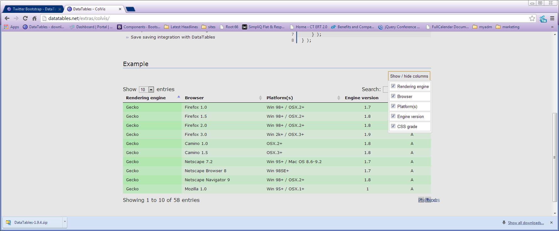
Datatable

Slide 22
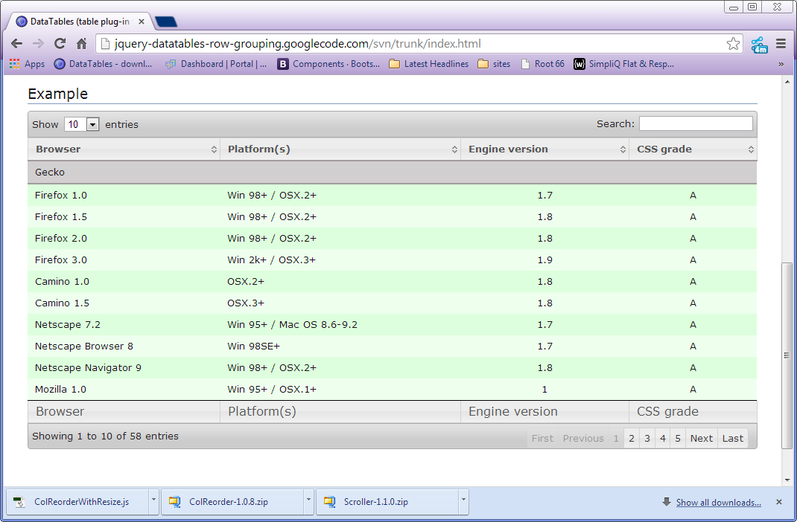
Datatable

Slide 23
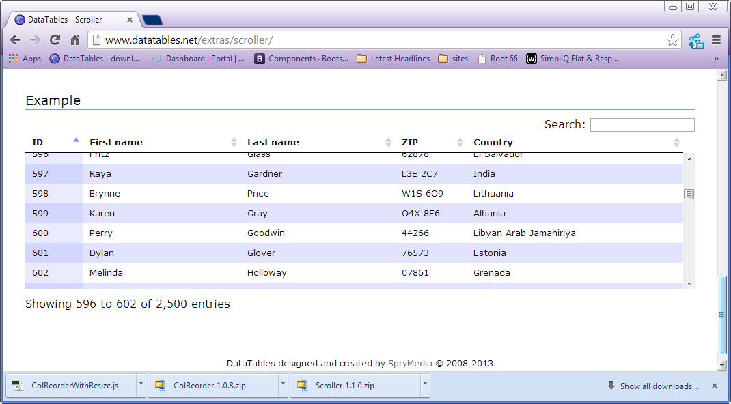
Datatable

Slide 24
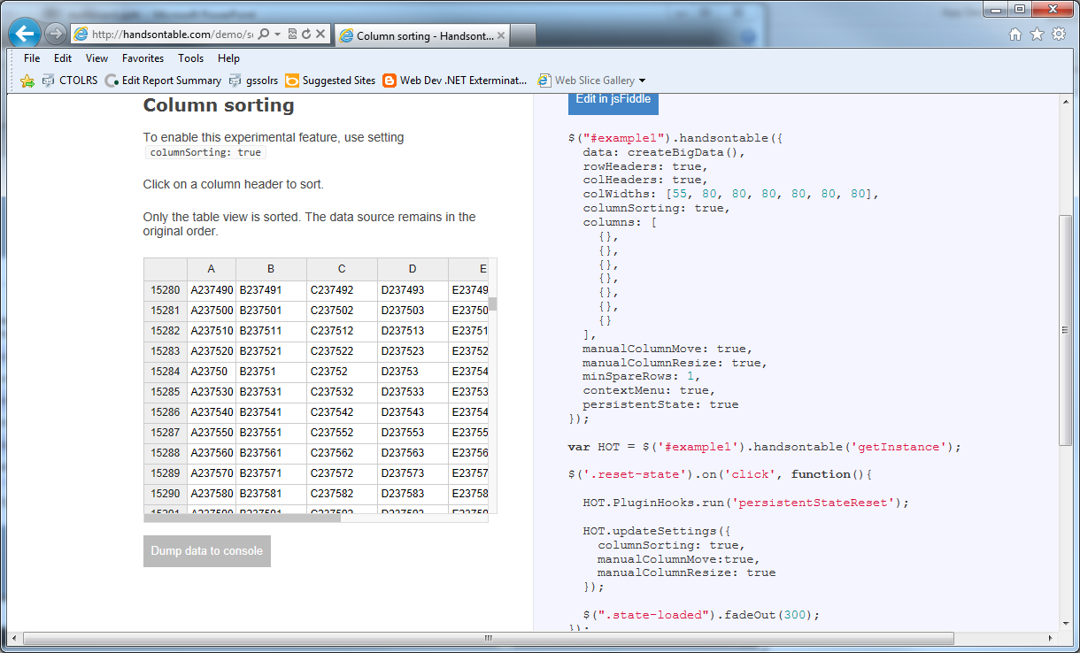
HandsonTable

Slide 25
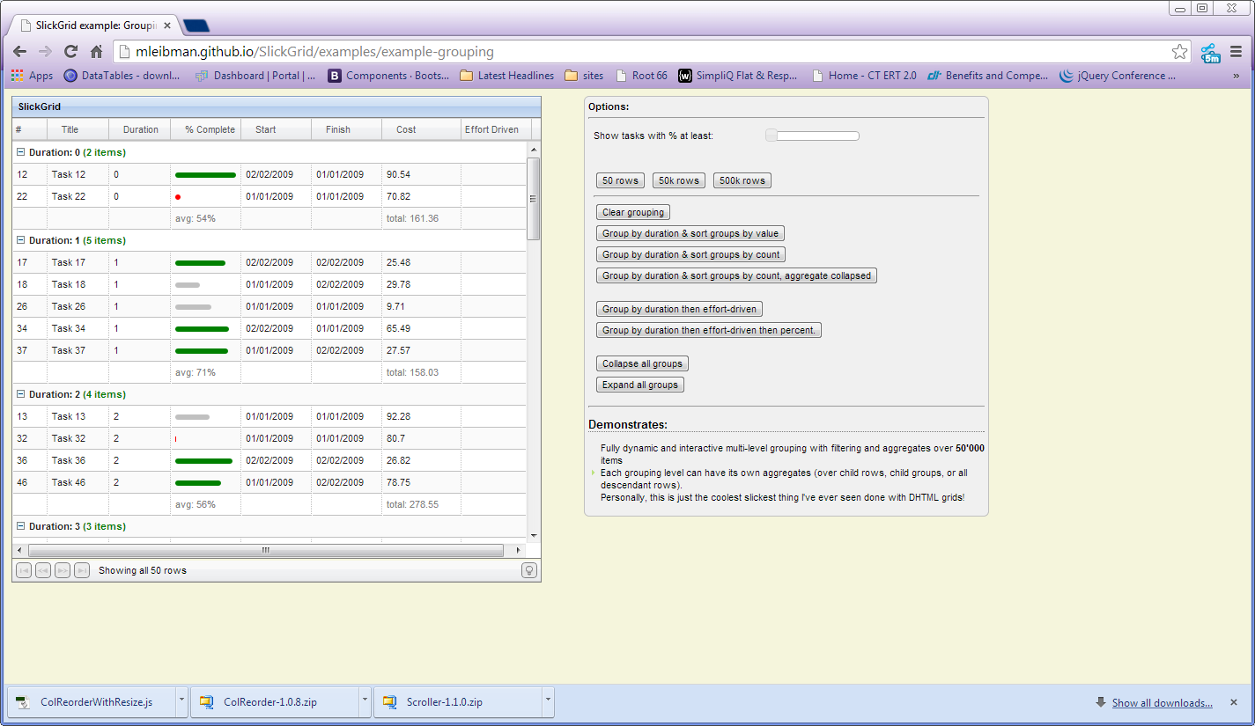
Slick Grid

Slide 26
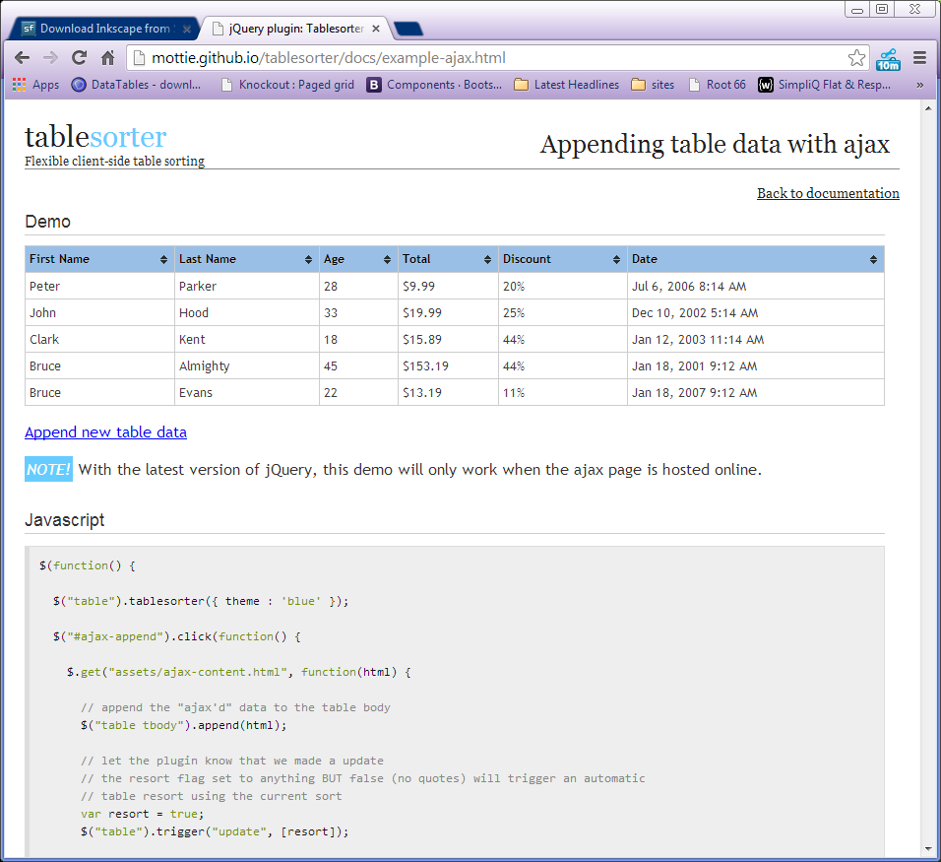
TableSorter

Slide 27
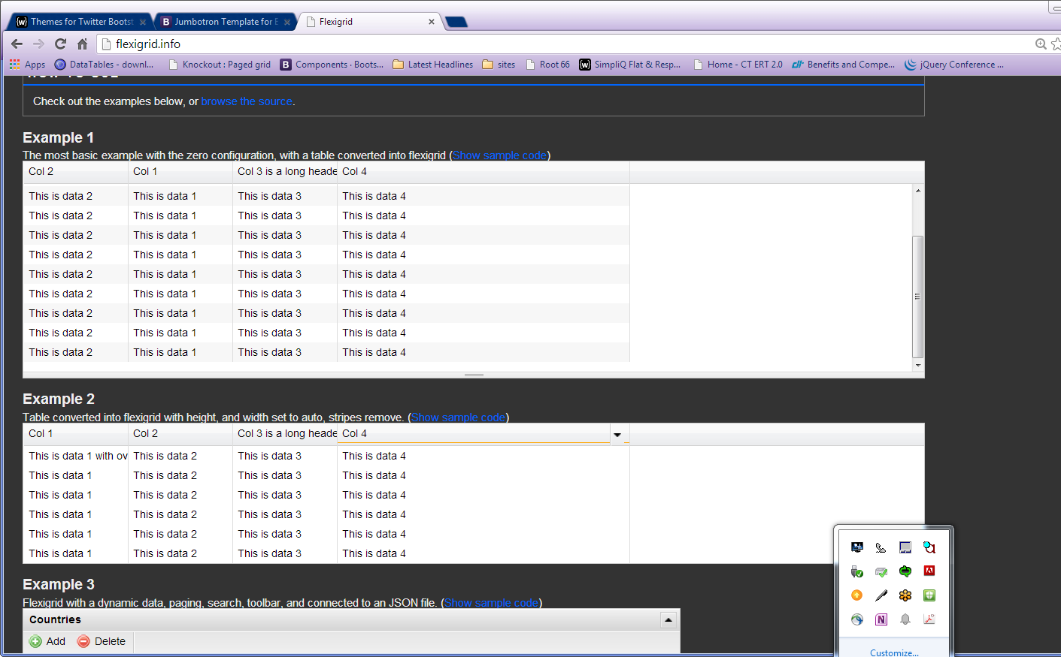
Flex Grid

Slide 28
Reference & Examples
http://stackoverflow.com/questions/3127503/sorting-table-columns-with-jquery-table-sorter
http://www.kryogenix.org/code/browser/sorttable/

Slide 29
4. Pick List

Slide 30
Pick List Basic Requirements
Add Remove Items
Add All Remove All Items
Reorder Items
Skinnable
Draggable
Fixed Items
Notes:
Picklist (add/remove columns to customize table display)
Purpose: To allow user to customize columns to display in datatable.
Requirements:
Add/remove columns:
Move individual column from left to right to display in table
Select and click button
Select and drag/drop
Move individual column from right to left to remove from table display
Select and click button
Select and drag/drop
Move multiple columns from left to right to display in table
Shift + click/ Control + click and click button
Shift + click/Control + click and drag/drop
Move multiple columns from right to left to remove from table display
Shift + click/ Control + click and click button
Shift + click/Control + click and drag/drop
Provide button that moves all columns from left to right to display all in table
Provide button that moves all columns from right to left to remove all from table display
Need ability to restrict certain columns from being removed
Order columns (list from top to bottom indicates table column order from left to right):
Move individual column up
Select and click button
Select and drag/drop
Move individual column down
Select and click button
Select and drag/drop
Move multiple columns up
Shift + click/ Control + click and click button
Shift + click/Control + click and drag/drop
Move multiple columns down
Shift + click/ Control + click and click button
Shift + click/Control + click and drag/drop
Provide button that moves all selected columns to top of list
Provide button that moves all selected columns to bottom of list

Slide 31
Pick List Recommendation
JQuery UI provides all the functionality we need
Can be linked to styles from TBS stack.
Already have a pretty functional prototype, just needs to be styled.
Need to communicate best implementation based on how code would be generated.
Sample in Git project.

Slide 32
Pick List Basic Requirements
Page split
Resize Widgets
Manage Widgets
Style Guide Compliance
Responsive
 | Native/Jquery-1 | Native/Jquery-2 | Jquery custom
Move Single Items Between two lists | x | x | X
Move multiple items between two lists | x | x | X
Move all | x | x | X
Restrict item* (poor usability – if you cant pick unpick it, it doesn’t belong in a picklist)
Move Up Down |  |  | X
List Items/ Option Menu | option | option | li
Drag | x | x | x
Notes | Could be extended | Could be extended | I built this.

Slide 33
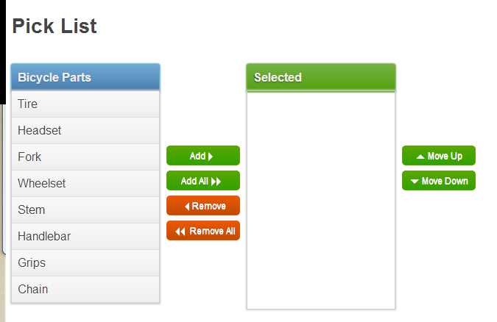
Pick List Example from Web

Slide 34
Pick List Reference
Basic sample from https://code.google.com/p/jquery-ui-picklist/wiki/Demos
jQuery UI Multiselect - http://quasipartikel.at/multiselect_next/
Build a hybred solution from these two demos… http://jquerywall.com/multi-transfer-jquery-ui-selectable/

Slide 35
Pick List 2 - (Manage Favorites)
Notes:
Modified Picklist (add/remove items from list and select to display data – current example is Manage Favorites)
Purpose: 1) To allow user to find data and add it to a list.
2) To allow user to select a list item to display full data results.
3) To allow user to remove item from list.
Requirements:
Search Area (see Manage Favorites in VA-OLRS)
Left panel with “Search” function
Area to display search results
Button to add record to list (right panel)
List Area (see Manage Favorites in VA-OLRS)
Right panel with list box
Ability to select item in list
Area to display full data results from selected item
Remove button to remove item from list
May need “edit” functionality to make changes to item

Slide 36
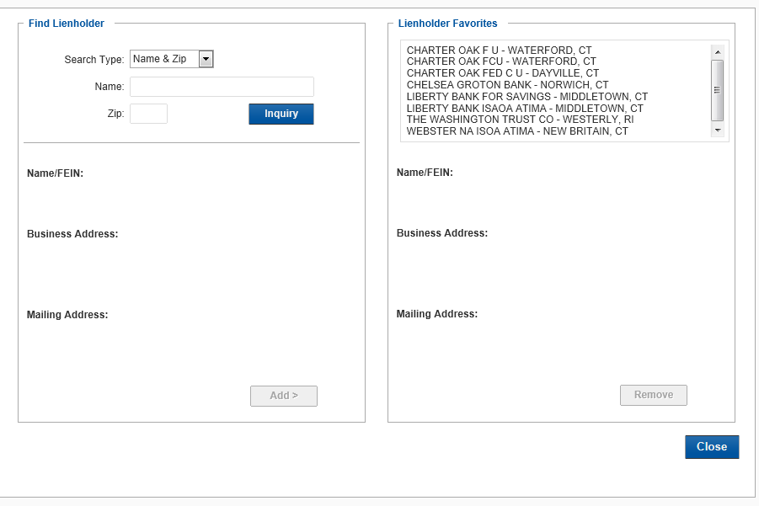
Pick List 2 - (Manage Favorites)
Notes:
Modified Picklist (add/remove items from list and select to display data – current example is Manage Favorites)
Purpose: 1) To allow user to find data and add it to a list.
2) To allow user to select a list item to display full data results.
3) To allow user to remove item from list.
Requirements:
Search Area (see Manage Favorites in VA-OLRS)
Left panel with “Search” function
Area to display search results
Button to add record to list (right panel)
List Area (see Manage Favorites in VA-OLRS)
Right panel with list box
Ability to select item in list
Area to display full data results from selected item
Remove button to remove item from list
May need “edit” functionality to make changes to item

Slide 37
Pick List 2 - Purpose (Manage Favorites)
Modified Picklist (add/remove items from list and select to display data – current example is Manage Favorites)
Purpose:
To allow user to find data and add it to a list.
To allow user to select a list item to display full data results.
To allow user to remove item from list.
Notes:
Modified Picklist (add/remove items from list and select to display data – current example is Manage Favorites)
Purpose: 1) To allow user to find data and add it to a list.
2) To allow user to select a list item to display full data results.
3) To allow user to remove item from list.
Requirements:
Search Area (see Manage Favorites in VA-OLRS)
Left panel with “Search” function
Area to display search results
Button to add record to list (right panel)
List Area (see Manage Favorites in VA-OLRS)
Right panel with list box
Ability to select item in list
Area to display full data results from selected item
Remove button to remove item from list
May need “edit” functionality to make changes to item

Slide 38
Pick List Requirements 2 (Manage Favorites)
Search Area (see Manage Favorites in VA-OLRS)
Left panel with “Search” function
Area to display search results
Button to add record to list (right panel)
Notes:
Modified Picklist (add/remove items from list and select to display data – current example is Manage Favorites)
Purpose: 1) To allow user to find data and add it to a list.
2) To allow user to select a list item to display full data results.
3) To allow user to remove item from list.
Requirements:
Search Area (see Manage Favorites in VA-OLRS)
Left panel with “Search” function
Area to display search results
Button to add record to list (right panel)
List Area (see Manage Favorites in VA-OLRS)
Right panel with list box
Ability to select item in list
Area to display full data results from selected item
Remove button to remove item from list
May need “edit” functionality to make changes to item

Slide 39
Pick List (Manage Favorites)
List Area
Right panel with list box
Ability to select item in list
Area to display full data results from selected item
Remove button to remove item from list
May need “edit” functionality to make changes to item
Notes:
Modified Picklist (add/remove items from list and select to display data – current example is Manage Favorites)
Purpose: 1) To allow user to find data and add it to a list.
2) To allow user to select a list item to display full data results.
3) To allow user to remove item from list.
Requirements:
Search Area (see Manage Favorites in VA-OLRS)
Left panel with “Search” function
Area to display search results
Button to add record to list (right panel)
List Area (see Manage Favorites in VA-OLRS)
Right panel with list box
Ability to select item in list
Area to display full data results from selected item
Remove button to remove item from list
May need “edit” functionality to make changes to item

Slide 40
Pick List (Manage favorites) Proposed Solution
Development Considerations:
Chunk this into feature sets
Start with previous pick list, then add filter and edit features.
Pick list fires 2 queries, right side is populated via separate query, and left side starts empty and populated via explicit query.
It might look better if it uses a default pagination that populates it with the results of the last query.
Unless it brings back all the data in the first query, a third query needs to fire when (if) a user wants to see details or edit a favorite. This occurs in a third panel. Below the favorites panel on the right.

Slide 41
Manage Favorites Usability Challenges
Goes outside expected behavior for a Pick- List
Lists un-pickable items
Editing in list
Drag
What does detail show?

Slide 42
Research on managing favorite lists
Facebook - Friends and Groups Manager
Google+ Circles Manager
Apple - List manager
Android - Contact manager

Slide 43
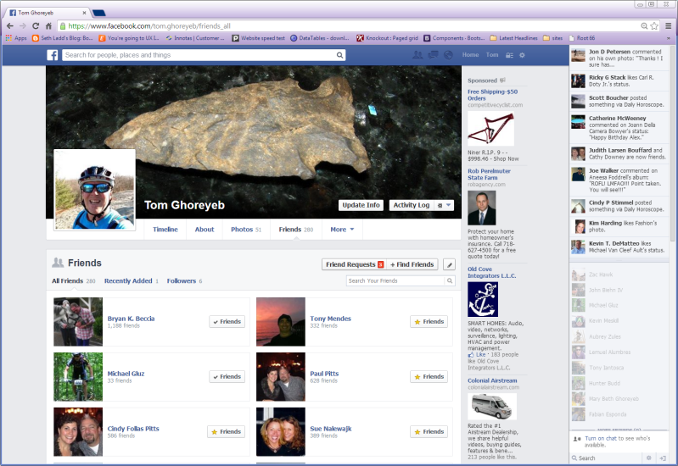
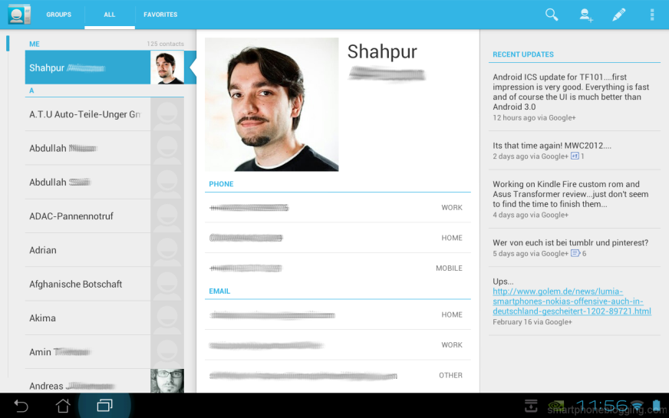
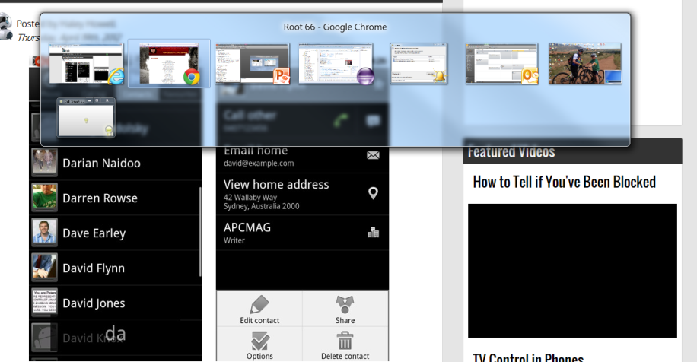
Research on managing favorite lists

Slide 44
Research on managing favorites
Commonality
Single pane for management
Filters for view and search
One-click add and remove items

Slide 45
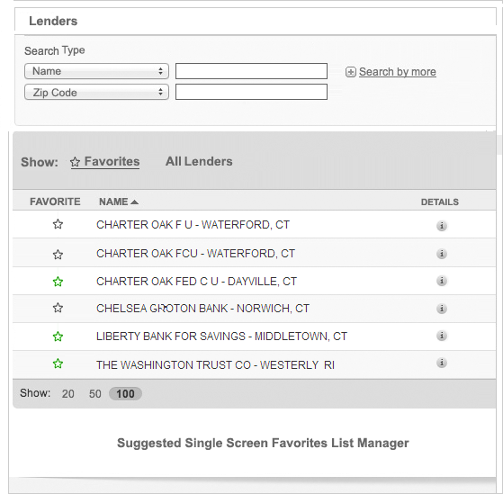
Suggested Alternative
Discrete Data Entry
For search
One Click add remove
More like a filter for two view, removes cognitive load comparing duplicates…
FIEN = unique, or internal UID
Find

Slide 46
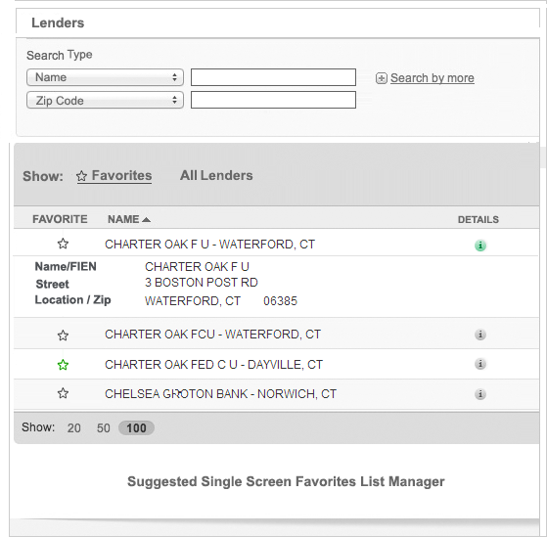
Suggested Alternative List manager
Inline Editing

Slide 47
5. Reveal Right Container
This is just a JQuery UI function applied to a DIV container. We can just create our own. We can use this section to define requirements, however.

Slide 48
Reveal Right Container
Requirements
Default Open
Opaque/Modal
Tab to right indicates when alerts have occurred
Contains live AJAX data

Slide 49
Reveal Right Container UI
Options (All can be styled with TBS)
JQuery Mobile – Need to review Heft of implementation
TBS/JQuery - Lighter
CSS + HTML 5 – Lightest, but will it support IE8?

Slide 50
Reveal Right Container UI
Implementation
Tab is always visible floated right. When you hit it to maximize, panel slides left with duplicate tab.
When how is it updated?
Cannot Scroll
Lots of widgets might slow down entire app, so it needs to have some sort of periodic ajax query to poll for changes, maybe linear queries?

